Slide 1




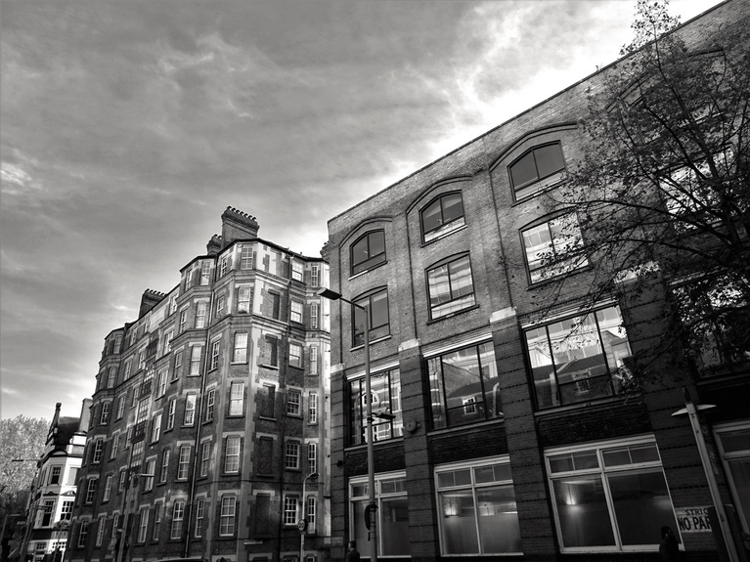
VI. Project
Management
GROUP 6

Slide 2
ICEBREAKER

Slide 3

Introduction
Content Overview
What is Project Management & Importance
Gantt Chart
Project Report

Slide 4
What is Project Management?
Project Management is the process of planning, organizing, and controlling resources to achieve specific goals within a given time frame.
It ensures that a project:
Is completed on time
Stays within scope
Uses resources efficiently

Slide 5




Importance of Project Management
Provides a clear direction for the project
Improves teamwork and coordination
Ensures project objectives are met
Helps
avoid delays

Slide 6




















Common Tools
Some common project management tools include:
Gantt Chart
Used for scheduling and tracking tasks
Project Report
Used for documenting the project process and results

Slide 7
What is a Gantt Chart

Slide 8
GANTT CHART
is a visual project management timeline that consists of horizontal bars, usually color-coded.
These bars show all the project tasks, when they are due, who is responsible, and how long each task will take.
Therefore, Gantt charts illustrate the start and finish dates of the terminal elements and summary elements of a project.
In other words, the Gantt chart assembles all pieces of tasks that are relative to a fixed deadline.

Slide 9
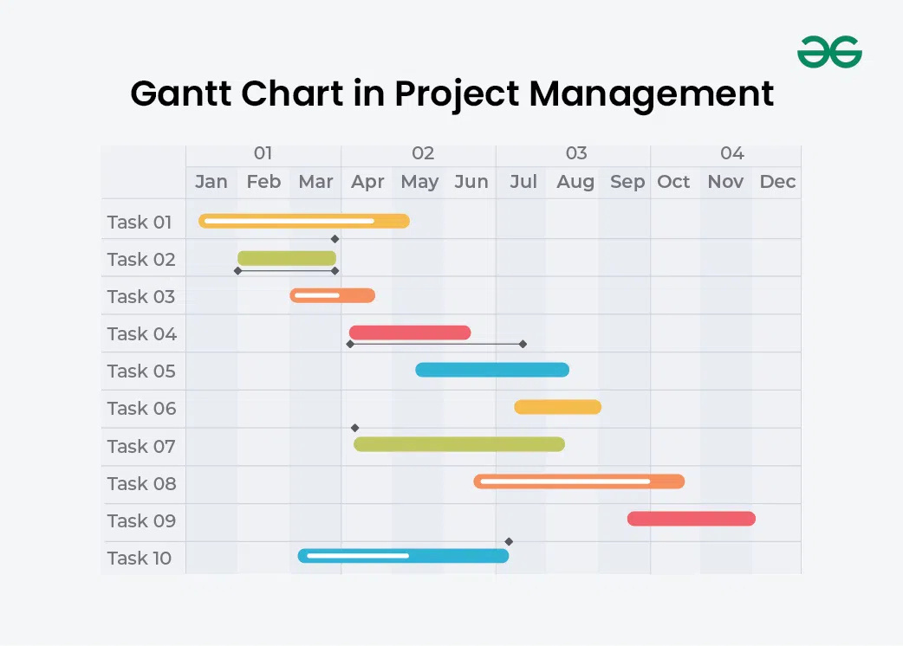
EXAMPLE OF GANTT CHART

Slide 10
What is the Purpose of a Gantt Chart?
Essentially, a Gantt chart arranges project tasks on a visual timeline, making it simple for project, programme, and portfolio managers to sketch out project plans. Gantt charts are utilised in resource management, project planning, project scheduling, and project tracking, among many other areas.
Break down the project into manageable tasks, identify dependencies, and allocate resources effectively.
Determine the sequence and duration of tasks, establishing a timeline for the project.
Monitor the progress of tasks, compare planned versus actual timelines, and identify any delays or issues.
Share project plans and progress with stakeholders, team members, and clients in a clear and understandable format.
Ensure that all team members are aware of their responsibilities and deadlines, facilitating collaboration and coordination within the project.

Slide 11
Steps in Creating a Gantt Chart

Slide 12
Identify and list all tasks
Write down all the activities that must be completed to finish the project, from start to end.
STEP 1.

Slide 13
Estimate start/end dates and duration
Decide when each task will begin, when it will finish, and how long it will take to complete.
STEP 2.

Slide 14
Lay out the timeline
Create a horizontal time scale that shows the project schedule.
STEP 3.

Slide 15
Draw task bars
Represent each task with a horizontal bar placed along the timeline to show its duration.
STEP 4.

Slide 16
Add task dependencies
Show which tasks must be completed before others can start.
STEP 5.

Slide 17
Assign resources or team members
Indicate who is responsible for completing each task.
STEP 6.

Slide 18
Include milestones
Mark important events or checkpoints that show major progress in the project.
STEP 7.

Slide 19
Monitor and update progress
Regularly adjust the chart to reflect completed tasks, delays, or changes in the schedule.
STEP 8.

Slide 20
Main Components
of a Gantt Chart

Slide 21
Tasks/activities – what work needs to be done.
Timeline – horizontal scale showing dates or units of time.
Duration bars – horizontal bars representing how long tasks take.
Milestones – special markers showing key achievements/points.
Dependencies – links showing which tasks rely on others.
Resources/assignees – who is doing the work.

Slide 22

Advantages and Disadvantages of
a Gantt Chart

Slide 23
Advantages
Provide a clear visual timeline of all project tasks.
Help plan and schedule tasks effectively.
Allow you to identify sequencing and dependencies.
Make it easier to track progress and deadlines.
Improve team communication and alignment.

Slide 24
Disadvantages
Time-consuming to create and update, especially manually or for large projects.
Can become complex or cluttered with many tasks.
Not always helpful for dynamic or agile projects with frequent change.
Limited detail on resources or task effort — duration doesn’t equal workload.
May not represent intricate dependencies well without extra tools.
Usually prioritizes schedule over budget or resource constraints.

Slide 25
Project Report
What it is and why it is important

Slide 26
WHAT IS A PROJECT REPORT?
A Project Report is a document that records everything about a project
It explains:
What the project is about
What was done
What was achieved
It shows the full story of the project from start to end

Slide 27

Importance of a Project Report
Keeps the project organized
WHY IS A PROJECT REPORT IMPORTANT?
Shows progress and results
Helps avoid confusion
Makes sure everyone knows what is happening
Can be used as proof of work

Slide 28

PROJECT REPORT IN SYSTEM ANALYSIS & DESIGN
Why it matters in system development
Records how the system was planned and built
Explains how problems were solved
Shows if the system worked as expected
Helps improve the system in the future

Slide 29
WHO USES THE PROJECT REPORT?
Project Manager – checks progress
Developers / Analysts – review system details
Clients / Users – understand the results
Teachers / Evaluators – check if requirements are met

Slide 30
Parts and Content
Project Report:

Slide 31
Project Report:
A Project Report is structured into key sections that guide the reader from the project’s background to its outcomes. Each part has a specific role:

Slide 32
Brief background of the project
Introduction
Why the project exists / problem addressed
Sets the stage for the report

Slide 33

Objectives
Main goals of the project
What success looks like
Defines the target outcomes

Slide 34


Scope
Excluded: Items outside project boundary
Included: Features, tasks, deliverables
Clarifies limits and focus

Slide 35
Methodology
Steps and approach used
Why this method was chosen
Techniques
Requirement gathering (interviews, surveys)
System design (flowcharts, diagrams)
Development (prototyping, coding)
Testing (user feedback, error checking)
Clear structure from start to finish
Allows early detection of issues
Ensures the final system meets user requirements
(research, prototyping, testing)

Slide 36
Timeline / Gantt Chart
Visual schedule of tasks and milestones
Shows duration and progress
Helps track if goals are on time

Slide 37
Results
Key deliverables produced
Outcomes or findings
Lessons learned from the project

Slide 38
Thank you.

